Slide 1
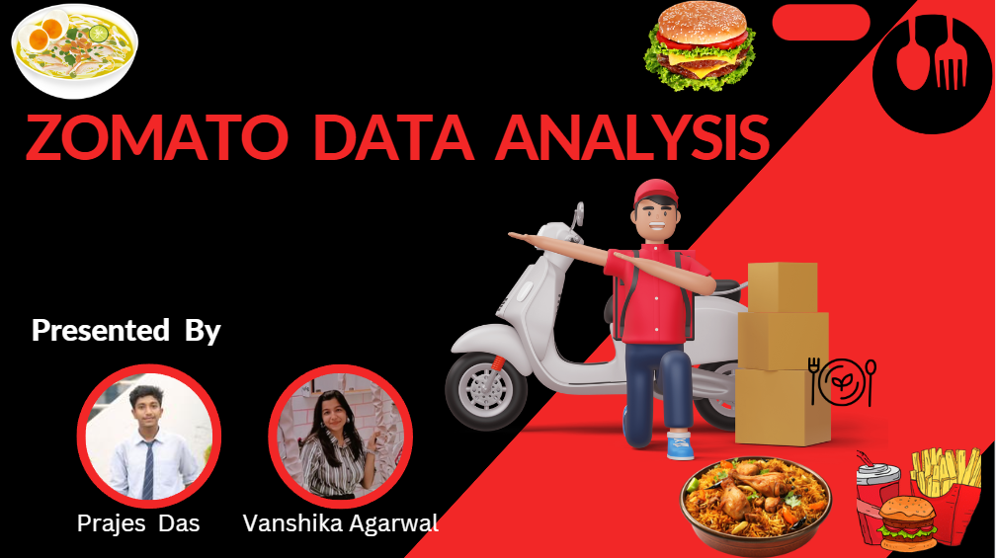

Slide 2



Power BI ZomatoData Analysis:
Unlocking Consumer Insights and Market Trends
This presentation explores the process of analyzing a Zomato dataset using Power BI to uncover valuable insights about consumer behavior and food service trends. By understanding customer preferences, restaurant performance, and market opportunities, businesses can make informed decisions and gain a competitive edge in the dynamic food industry.

Slide 3


Introduction
1
Zomato: A Global Platform
2
Data-Driven Insights
3
Actionable Insights
This project aims to leverage Zomato's rich dataset to understand customer preferences, restaurant performance, and market trends.
The analysis will provide actionable insights that can guide business strategies, improve customer experiences, and drive growth.
Zomato is a leading global food delivery and restaurant discovery platform, connecting millions of users with a vast network of eateries.

Slide 4

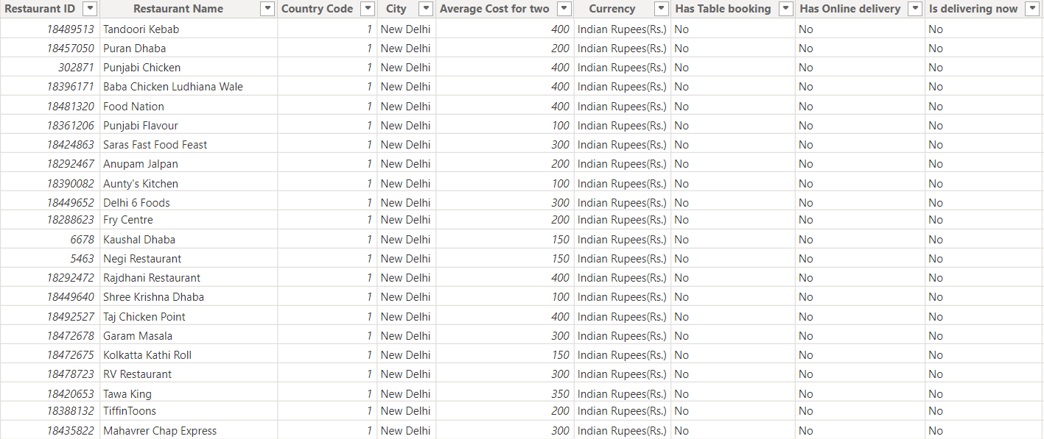
Dataset Overview
Table Name
Columns
Description
Zomato
21
Restaurant ID, Name, Location details, Cuisines, Average Cost, Ratings, etc.
Country Code
2
Country Code and Country Name

Slide 5

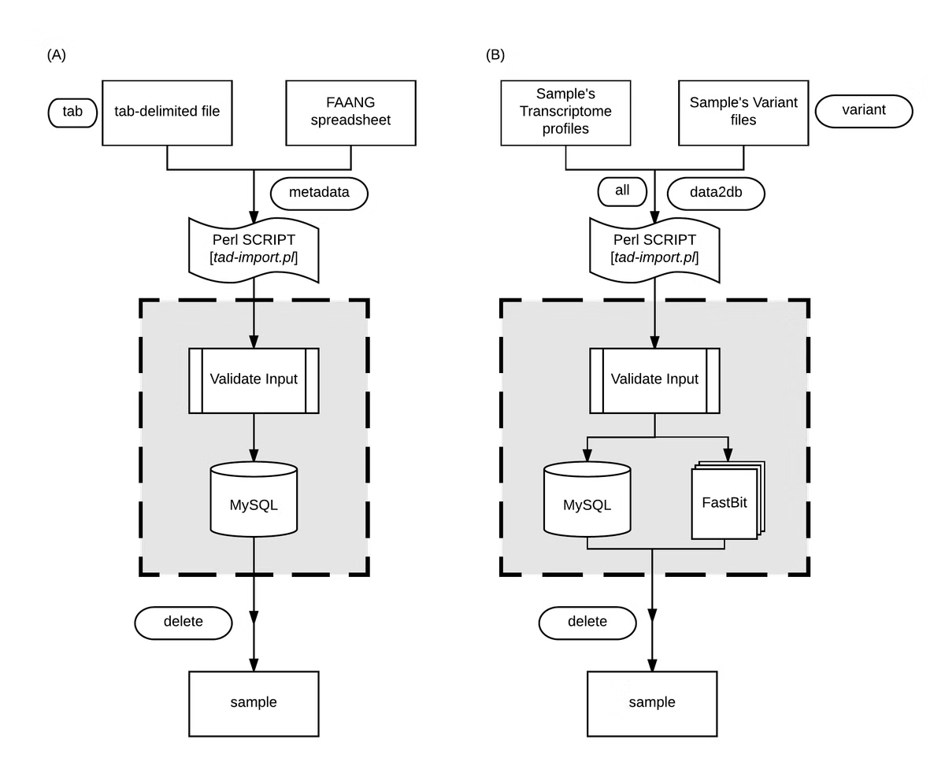
Data Import and Transformation
1
Data Import
The Zomato dataset was imported into Power BI, providing a foundation for analysis.
2
Data Cleaning
Unwanted columns were removed, and null values were addressed to ensure data accuracy and consistency.
3
Data Preparation
Data was prepared for modeling by transforming and standardizing formats to facilitate analysis and visualization.

Slide 6

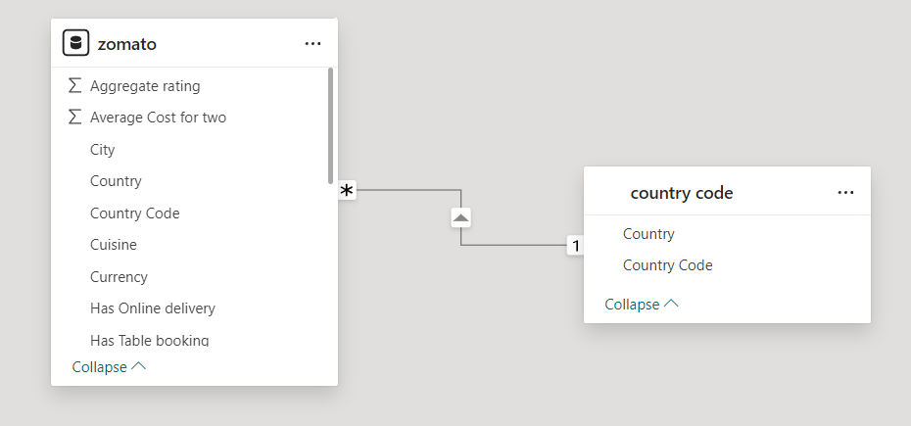
Data Modeling in Power BI
Relationship Establishment
Measure Creation
Data Integrity
Measures such as average ratings, restaurant counts, and price range calculations were created to provide meaningful insights.
Data modeling ensures accurate and consistent representation of data, enabling reliable visualizations and analysis.
Relationships were established between the Zomato and Country Code tables to enable cross-table analysis.

Slide 7
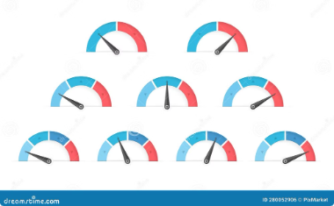
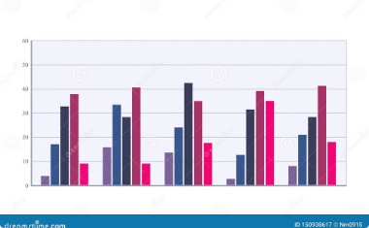

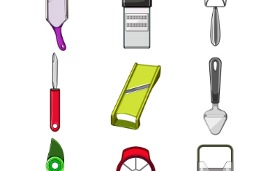
Data Visualization in Power BI
Gauge Visuals
Bar Charts
Tables
Slicers
Gauge charts were used to showcase the average aggregate rating and the highest restaurant cost, providing a visual summary of key metrics.
Bar charts displayed the distribution of restaurants based on user ratings, offering insights into customer satisfaction and popularity.
Tables presented detailed information about the number of eateries offering various cuisines and the votes received by restaurants.
A country slicer enabled filtering visualizations to gain focused insights for specific countries, providing granular analysis.

Slide 8
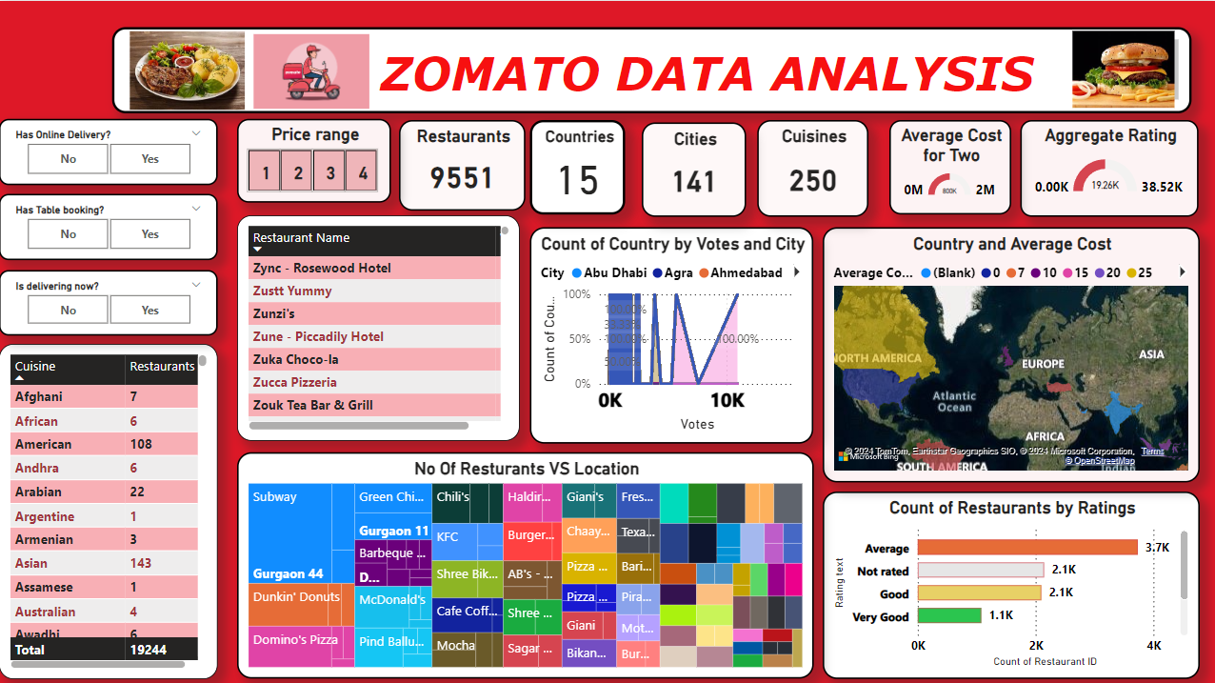

Slide 9
Key Insights from the Analysis
Overall Restaurant Count
Regional Variations
Restaurant Features
India emerged as the country with the highest number of restaurants, highlighting its vibrant food culture.
A significant percentage of restaurants offered table booking and online order facilities, indicating the growing trend of convenience.
A total of 9,551 restaurants were analyzed, providing a comprehensive overview of the food service landscape.

Slide 10





Business Recommendations
Expand Restaurant Categories
Explore expanding restaurant categories that are underrepresented in specific locations to cater to diverse customer preferences.
Target Locations with Lower Penetration
Focus on locations with fewer restaurants offering table booking and online orders to tap into potential market opportunities.
Consider Pricing Strategies
Employ regional analysis to understand pricing trends and develop competitive pricing strategies based on local market conditions.

Slide 11




Conclusion
Data-Driven Decisions
The insights gained from this analysis provide a strong foundation for making data-driven decisions that can optimize business operations.
Continuous Monitoring
Regular data analysis and monitoring are crucial for staying ahead of market trends and ensuring long-term success.
Competitive Advantage
Leveraging data-driven insights enables businesses to gain a competitive advantage in the ever-evolving food service industry.

Slide 12


